Slide 1
Social Technology and Business Decisions
The real business challenge with the Social Web
isn’t social media itself, but rather its relationship
to the business or organizational processes that
create the experiences that are talked about in the
first place. Understanding how your internal processes
drive the conversations that circulate on the
Social Web—and how social analytics can be used
to inform business decisions and potential process
changes that relates to them—is the hinge point in
moving to a social business.

Slide 2
1.Create a Social Business
The key to combining listening data, obtained via support forums and similar applications, and other information gathered through direct connection with your customers is that this needs to be connected to your business strategy and the processes that surround it.
In other words, traditional marketing is largely focused on market study (both pre and post) that informs a message. Listening in the simple sense conveys back to you the degree to which that message was consistent with the actual experience of customers and stakeholders, including in venues that you may not have originally envisioned. To understand it better have a look on innovation cycle.

Slide 3
Cont…
For example, an outbound marketing message may claim to be “Created for working mothers like you!” If it also turns out that the firm does not equitably promote women within the workplace, this contradiction will inevitably become known, very likely being spread through social channels.
This raises the requirements for active listening and the incorporation of customer feedback into your business processes.

Slide 4
The Innovation Cycle
The combination of social-media-based marketing and the application of Social CRM is powerful. Connecting customer intelligence and what is learned through active listening deeply into your business results in a customer-driven innovation cycle.
Driving your business or organization according to your business objectives is always your end goal.
In combination with an understanding of your audience, your business objectives are what dictate the specific actions you need to take.
As shown in given figure the connection between innovation and social engagement is directly applicable to social business and its attendant processes, including Social CRM.
This relationship spans the stages of learning, applying the ideas gained to design, and then iterating to steadily improve (sometimes in radical steps) what is offered to customers or cause related constituents in the marketplace.

Slide 5
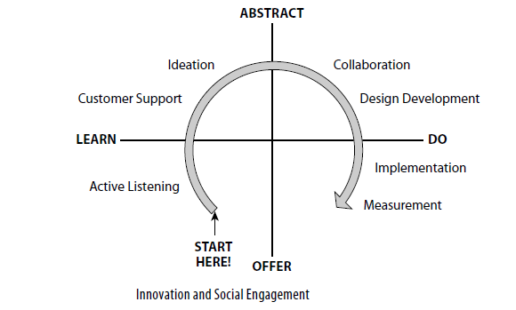
Cont…

Slide 6
2.Understand the Conversations That Matter
Listening to the conversations in your marketplace is the starting point in becoming a business that deeply integrates customer input. The application of more rigorous analytics to these conversations yields clues as to how an organization might use this input to improve a product or service.
Taken together, listening is by far the easiest entry into understanding what the Social Web is all about. By listening and in particular when using a dashboard-style monitoring tool you can quickly see what is being said about your brand, product, or service.
We can understand better to conversation that matter by following three important things
1. Consider the Workload 2. Active Listening 3. Touchpoint Analysis

Slide 7
Consider the Workload
If you’ve got a small brand, or you’re in an industry that isn’t talked about a lot, or you are a professional services consultant, realtor, or similar; you may have relatively few conversations that are of interest to you or require your attention.
To get an idea of just how seriously businesses are taking social analytics, use Google to search for “Gatorade social media mission control.”
It’s an amazing installation (myself having worked in Mission Control with NASA/JPL) from a technological perspective and a solid testament to just how important social analytics and understanding what is happening on the Social Web has become.

Slide 8
Active Listening
Active listening, a term coined by Rohit Bhargava, implies integrating what is being talked about outside of your organization with the processes inside your organization that are driving those conversations.
In other words, it means listening intently enough that you actually understand not only what is being said, but how and why it came about, and formulating at least a basic idea as to what you will do next because of it.

Slide 9
Touchpoint Analysis
As a product manager, I was immediately drawn to the simple reality that everything I did in terms of product design came down to one customer moment.
That moment is, of course, the point in time when a customer uses and experiences some aspect of the product I’d designed or brought to market. That moment, and only that moment, is the single truth that exists from the customer’s perspective. What happens when your customer plugs it in, turns it on, calls with a question, or shifts it into drive.

Slide 10
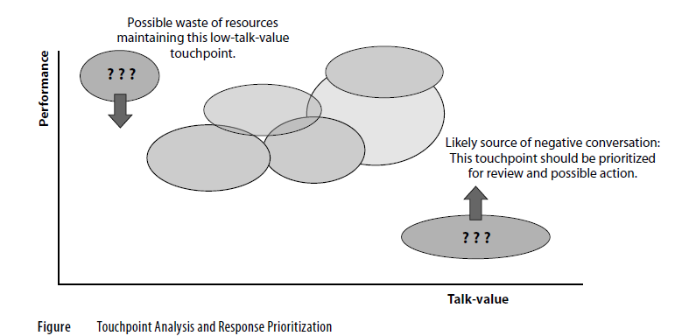
Cont…

Slide 11
Touchpoint Analysis: Bengaluru International Airport
?

Slide 12
3.Social CRM and Decision Support
Tracking and measuring the dynamics of a marketplace conversation to understand sources of influence, spot problems, and create loyal advocates is largely what drives the current interest in social analytics.
Beyond this, connecting the impact or more correctly, the underlying cause of these conversations deeply into business processes defines the emerging discipline of Social CRM.

Slide 13
Cont…
Social CRM includes the following fi ve elements:
• A genuine effort on the part of the firm or organization to understand and consider the point of view of its customers and/or stakeholders, for whom the business or organization exists.
• An understanding and mapping of the social graphs, communities, and the social applications that connect individuals within your overall audience to each other (rather than to you) and thereby gaining an insight as to how you fit into their world.
• The identification of the specific difference between the activities your customers want to take ownership for versus those in which they look to you for guidance, relief, assistance, and similar contributions from you that improve their quality of life.
• The optimization of your commerce or conversion processes given the role of customers and stakeholders in the conversations that impact conversion.
• The connections touchpoints between your activities and those of your customers with the internal business processes that drive the experience that occurs at those touchpoints.

Slide 14
Cont…
For better understanding of Social CRM and Decision Support we will consider following 6 points.
The Customer Point of View (POV)
Map the Social Graph
Integration of Listening
Customer Support and Social CRM
Activate Your Customers: Control vs. Leadership
Collaborative Processes
Now we will explain each of them one by one

Slide 15
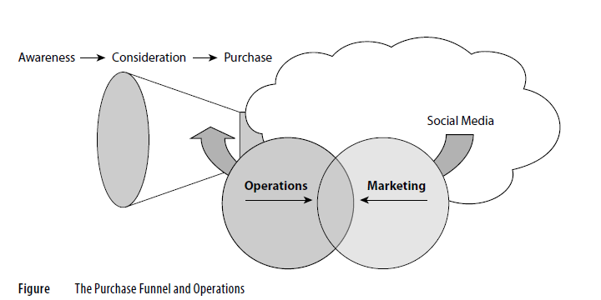
The Customer Point of View (POV)
Social analytics, even in their purely qualitative form, provide powerful insights into the personal views of your customers. Because the analytics platforms collect large amounts of data, you can get beyond the anecdotes of focus groups. Because the tools are real time (or near real time) and ongoing, you can also move beyond one off surveys.

Slide 16
Map the Social Graph
Once you’ve got a handle on what is being said, the next step in implementing a Social CRM program is understanding who said it.
By “who said it” I’m not referencing the personal details of a specific individual, though you may in some cases be able to discern this information from actual customer data or a similar source.

Slide 17
Integration of Listening
The step-up in business value from listening/monitoring to actively listening and responding along with measuring is seen in the usefulness of the KPIs as drivers business processes that connect what is learned on the Social Web with the way in which the business operates.
The integration with your business or organization occurs fi rst in the “routing” processes and then in “tracking.”
Of course, the act of responding itself is a business process: That, however, is really a function of having or not having a listening program and does not in itself imply a “social business” orientation.
To be sure, listening is better than not listening, and listening combined with responding is a solid idea. But to really see the benefi t of a social business program within your organization, you’ve got to take a further step.

Slide 18
Customer Support and Social CRM
Salesmanship begins when the customer says “no.” Support begins when the customer says “yes.” In a sort of basic truth about business, this view of customer support clarifies one of the biggest opportunities a firm or organization will ever have:
The opportunity to make those who were happy to buy from you even happier that they did. I point this out because in too many businesses, whether by accident or actual design, customer support feels to customers like an obligation whose cost is to be minimized.

Slide 19
Activate Your Customers: Control vs. Leadership
Consider customer/product interactions like those described in the case of Dell, and in particular the roles played by the customer versus the business or organization.
The people creating and posting the content (for example, customers uploading pictures) have immediate control of the content and hence control over their side of the conversation.
It’s “immediate” because it applies to this particular interaction: they get to defi ne what is being said right now and to influence others who are listening right now.

Slide 20
Collaborative Processes
With the audience connected to the business, and employees and customers connected to each other, knowledge begins to fl ow along pathways that prior to the widespread adoption of social technologies were not always seen as primary to the operation of a business.
The high degree of connectivity and the ease with which consumers, business partners, and other stakeholders can talk about brands, products, and services is (overall) a beneficial thing long term, it leads to better products and services.

